Slide 1
ECO346 | DATA VISUALIZATION TECHNIQUES FOR ECONOMISTS
1/5
Visualizing Annual Earnings
by Age
PSLM sample • Sindh Urban • Ages 15–64
REGISTRATION NUMBER
VARIANT SPECIFICATION
FA24-BEDS-011
Sindh Urban • Weighted analysis using household weights

Slide 2
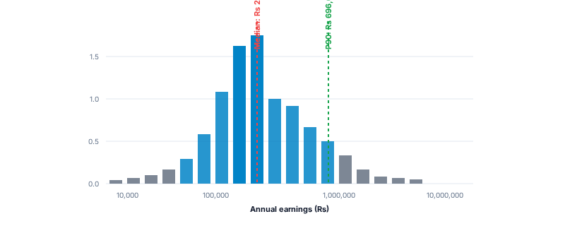
Q2 • EARNINGS DISTRIBUTION
Annual earnings are strongly spread out
2/5
Positive annual earners • Sindh Urban • Ages 15–64
VALID EARNERS After sample and missing-value filters
Most Earners Receive Less Than the Highest-Earning Group
2,644
WEIGHTED MEDIAN
Rs 264,000
WEIGHTED P90
Rs 696,000
P90 / P10 RATIO
5.8×
P10 = Rs 120,000
Key finding: the 90th-percentile earner receives about 5.8 times the 10th-percentile earner. The weighted median (Rs 264,000) is slightly above the unweighted median (Rs 252,000).
Source: PSLM 2019–20 | Sindh urban earners, ages 15–64, positive earnings | Weighted by hhweight | 2 earners outside histogram range
Source: PSLM subset. Weighted quantiles use household weight (hhweight).
ECO346 • Data Visualization Assignment • Sindh Urban

Slide 3
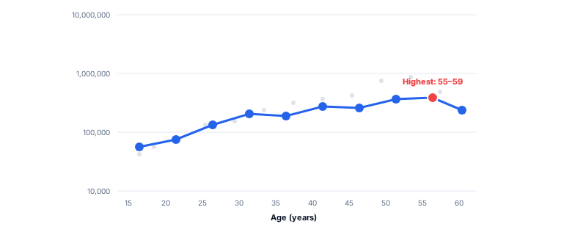
Q3 • AGE AND EARNINGS
Weighted mean earnings generally rise with age
3/5
Band means use household weights; age bands are five years wide
PEAK EARNINGS AGE BAND
Weighted Mean Earnings Peak at Ages 55–59
Ages 55–59
Weighted Mean: Rs 542,400
SELECTED AGE-BAND RESULTS
Age band | n | Weighted mean
25–29 | 398 | Rs 303,153.9
45–49 | 250 | Rs 431,696.7
55–59 | 157 | Rs 542,400.0
60–64 | 72 | Rs 414,262.5
Interpretation: earnings do not increase smoothly at every age band. The pattern is consistent with experience-related earnings growth, but the cross-sectional data cannot prove that individuals' earnings rise as they age.
PSLM 2019–20 | Sindh urban earners, ages 15–64, with positive annual earnings | Weighted by household weight | Hollow markers indicate age bands with fewer than 30 earners
Source: PSLM 2019–20 subset microdata.
ECO346 • Data Visualization Assignment • Sindh Urban

Slide 4

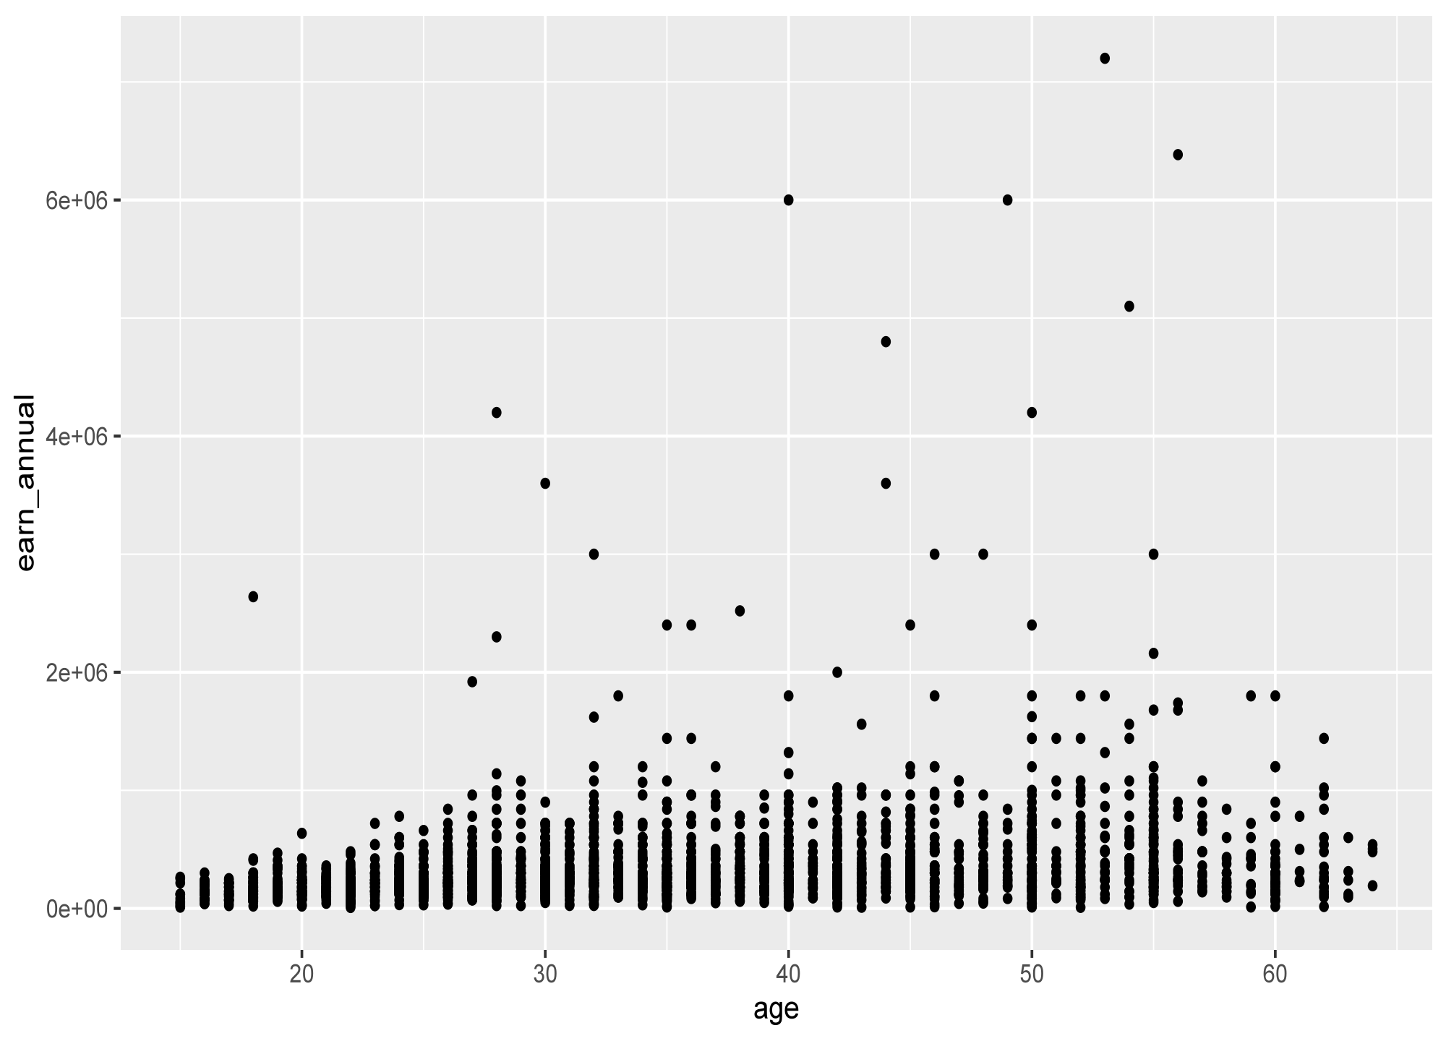
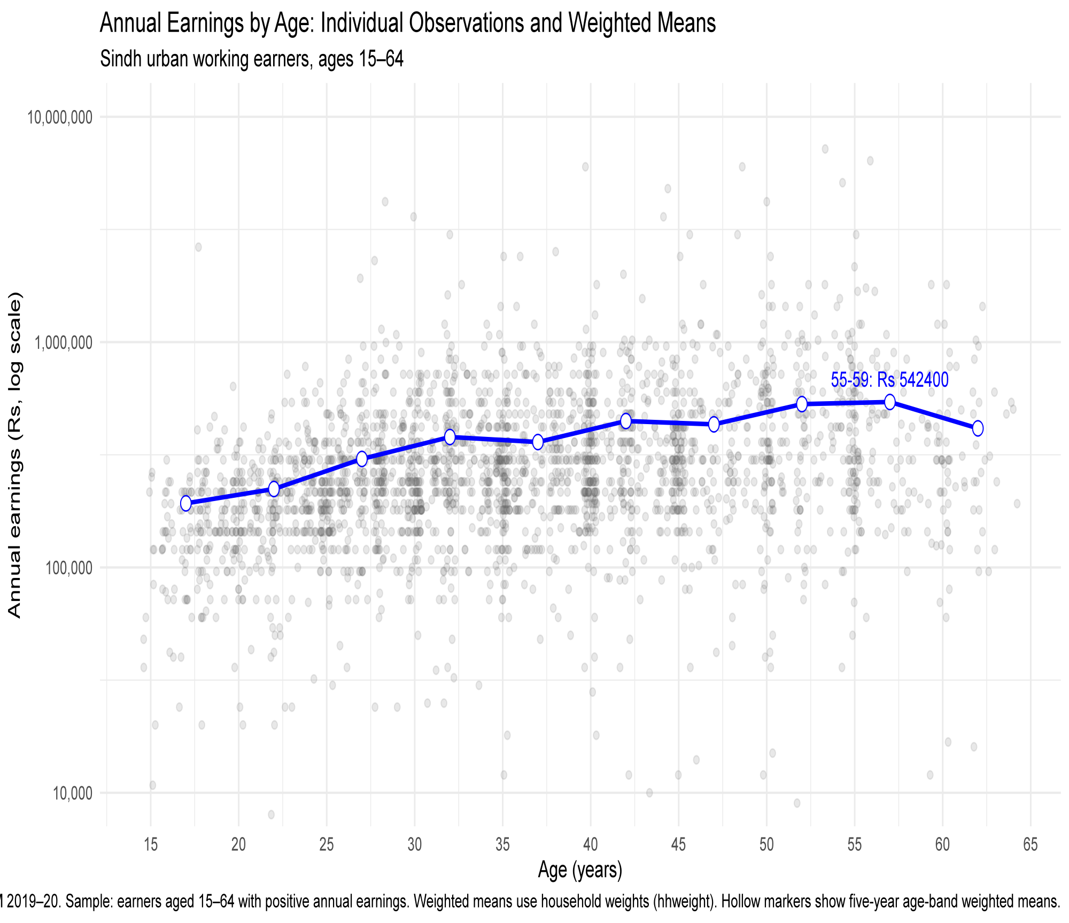


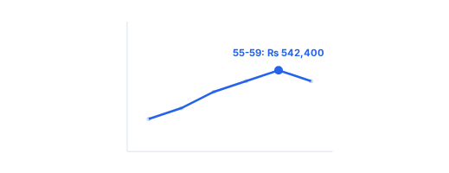
Q4 • DESIGN AND REPRODUCIBILITY
Redesign makes the age pattern easier to read
4/5
DEFAULT GRAPH
RAW POINTS ONLY
REDESIGN GRAPH
LOG SCALE + WEIGHTED MEANS
•
•
•
•
•
•
Raw data points: Individual observations overlap heavily.
Transparency: Reduces visual effect of overlapping points.
Overplotting: High density makes central trends difficult to see.
Log scale: Makes the earnings distribution easier to compare.
Unclear comparison: Age-wise differences are obscured.
Weighted mean markers: Highlight key structural differences across age groups.
Side-by-Side Makeover Comparison
ECO346 • Data Visualization Assignment • Sindh Urban

Slide 5
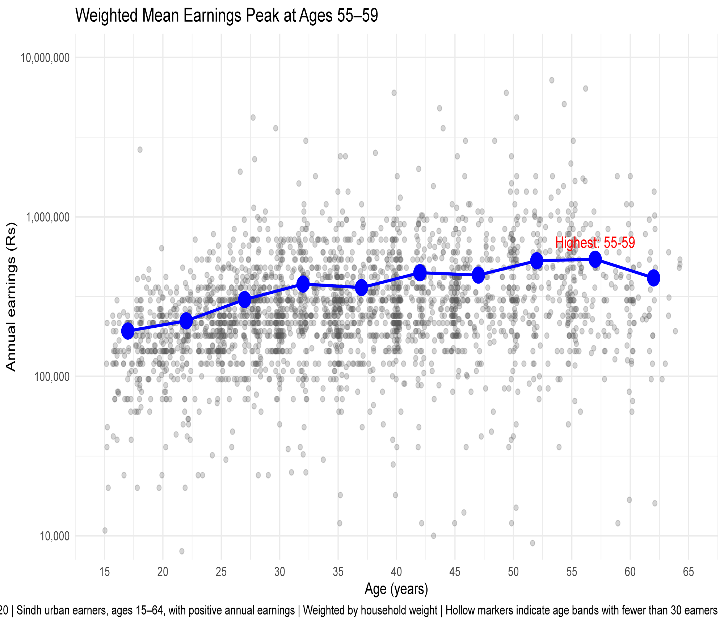
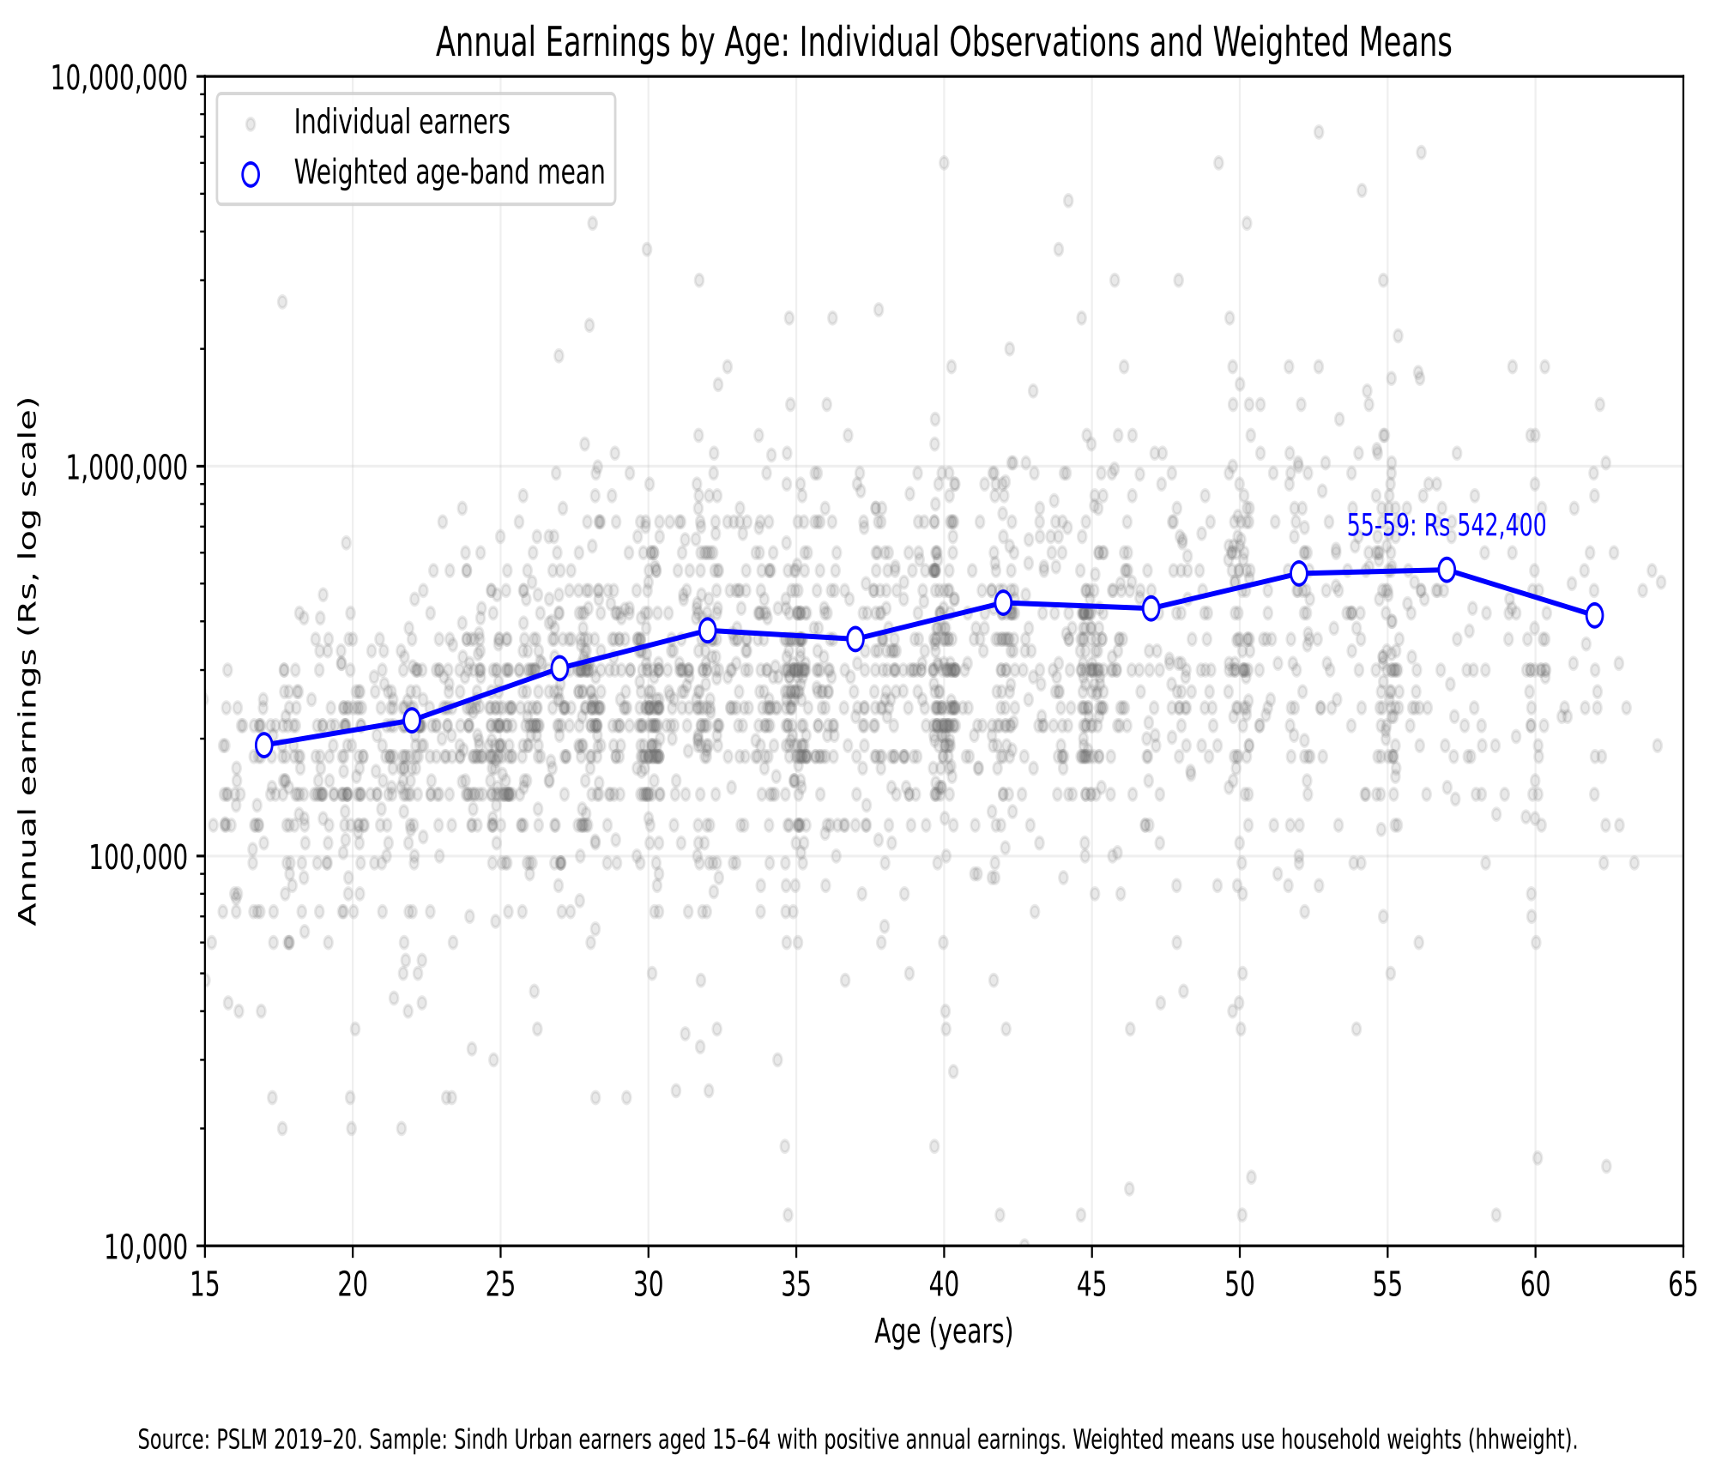


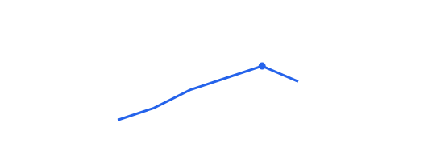
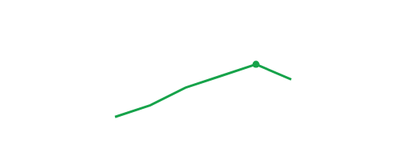
Q5 • REPRODUCIBILITY AND VALIDATION
Cross-Validation between R and Python Pipelines
5/5
R Pipeline Output
R / ggplot2
Python Pipeline Output
Python / matplotlib
Reproducibility: Obtaining identical results using the same dataset and source code.
Validation: Verifying calculation correctness by cross-checking execution across dual environments.
Cross-check Result: Ages 25–29 weighted mean annual earnings exactly match at Rs. 303,153.9 across both R and Python.
PSLM 2019–20 Microdata Analysis • Sindh Urban
ECO346 • Data Visualization Assignment • Sindh Urban

